Slide 1
Time Series Forcasting
Rajesh Thakur

Slide 2
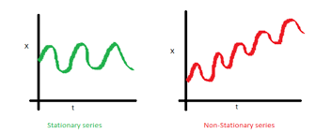
ARIMA(Auto Regressive Integrated Moving Average)
ARIMA is a statistical model that could be used for time series prediction of future values using the past values and lagged forcast error.
Auto Regressive:- In auto regressive model, we forcast the variable of intrest using a linear combination of the past values of the variable.
yt=c+ϕ1yt−1+ϕ2yt−2+⋯+ϕpyt−p+εt
gama is auto regressive co-efficient
et is the noise introdused at time t
p auto regressive parameter and it is the first parameter that must be define
Integrated:- Differencing method with d
Non Stationary --→. Stationary
Moving Average:- Moving average model uses the past forcast errors in the regression-like model
Yt = c + εt + ϕ1 εt-1 + ϕ2 εt-2 + ϕ3 εt-3 …. + ϕq εt-q
Φ – Moving average co-efficient
q- is the another important parameter that must be define for ARIMA
time series with no trends or seasonality are stationary
Time series with trends or with seasonality are non stationary

Slide 3
ARIMA
Auto Regressive Integrated Moving Average
p
d
q
d
ACF and PACF plot
How to find (p,d,q)
Grid search

Slide 4
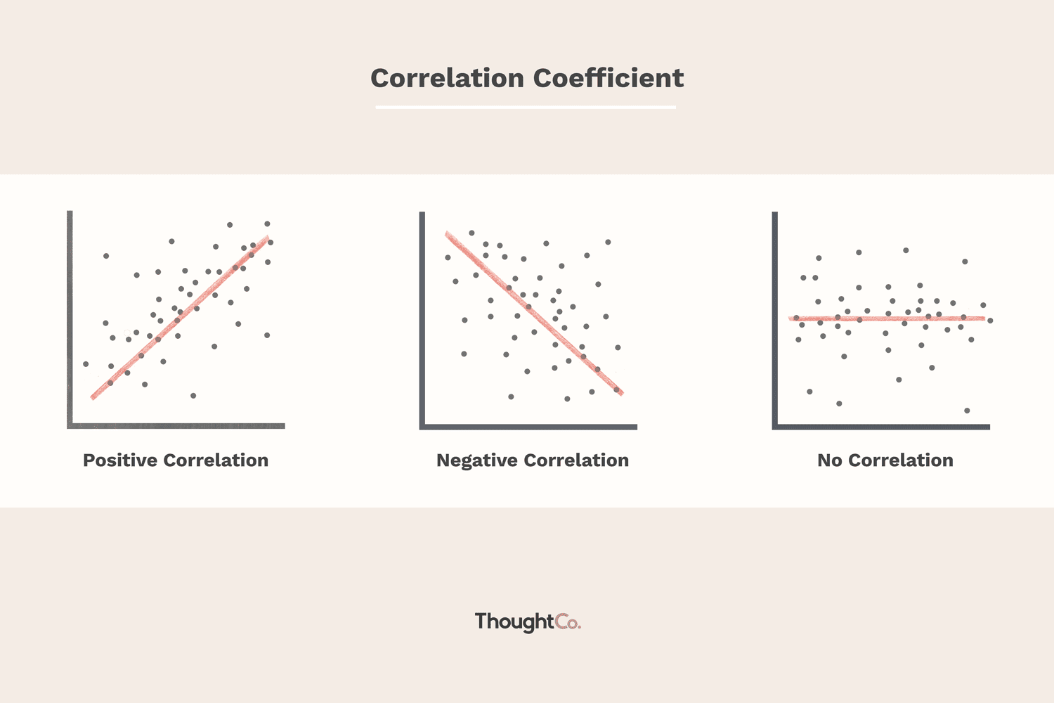
ARIMA
Correlation

Slide 5
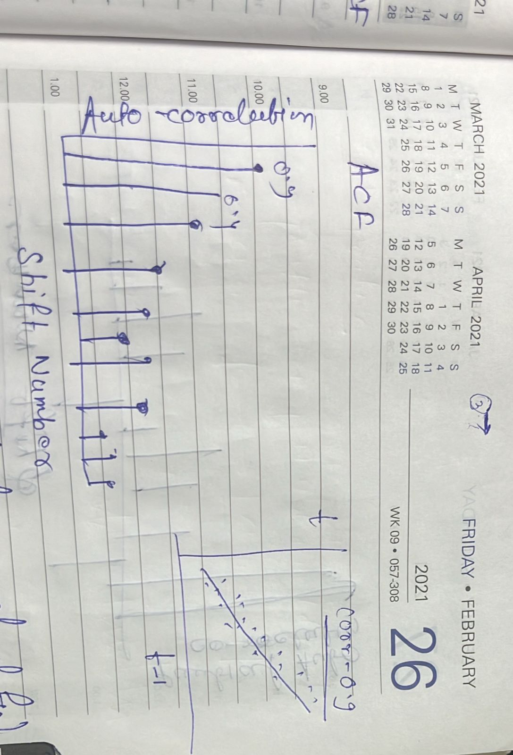
ACF
Just one variable

Slide 7
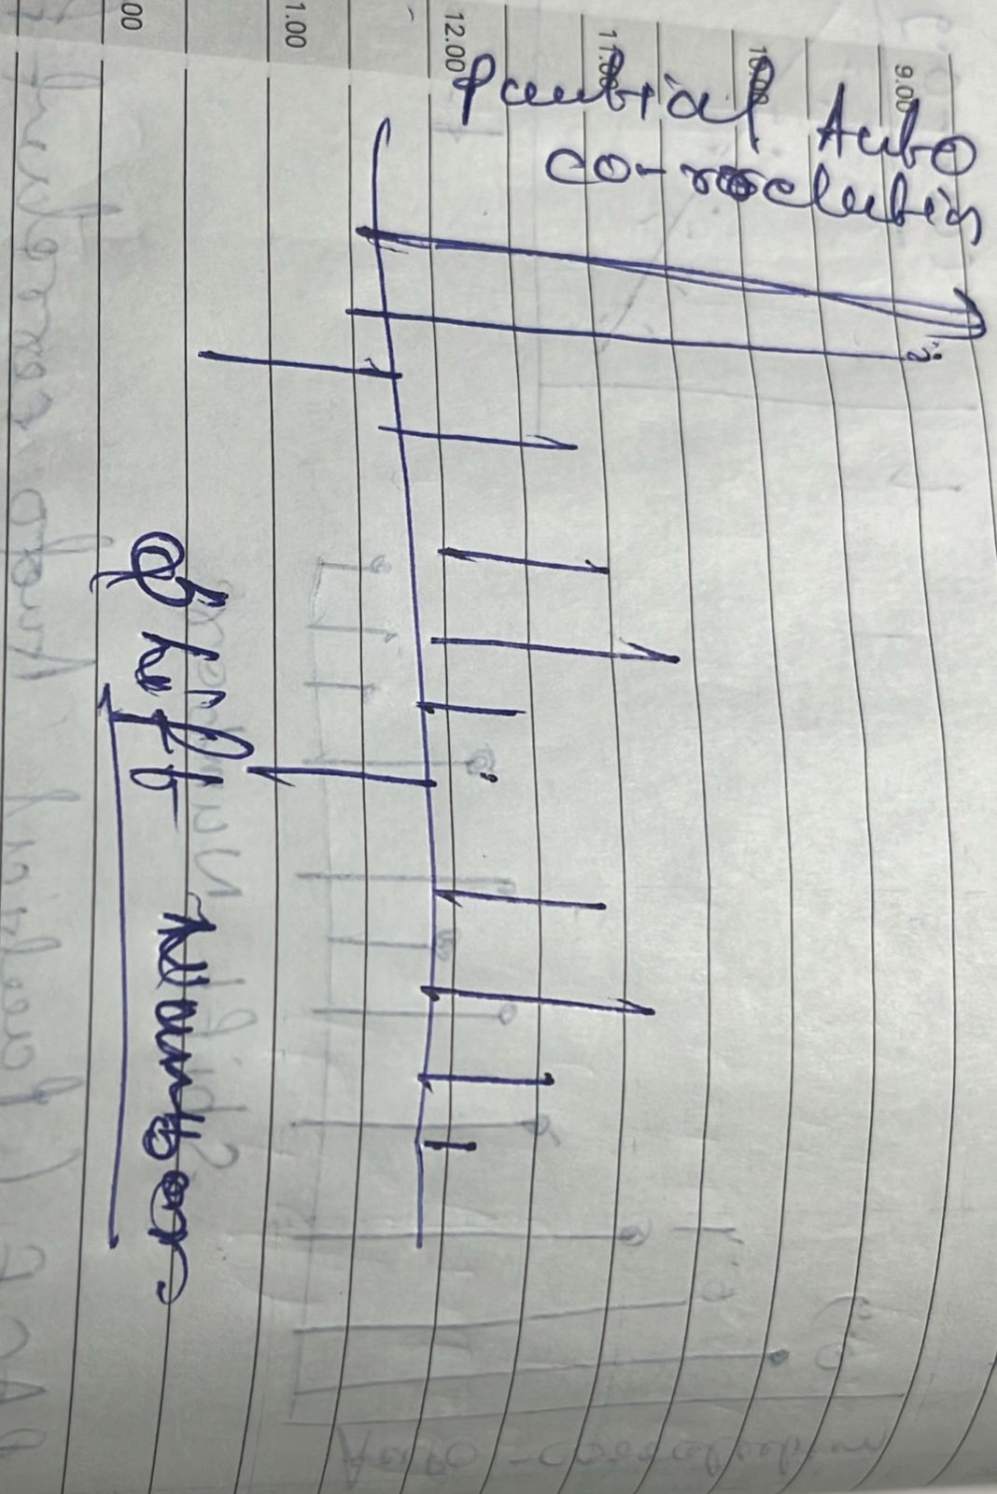
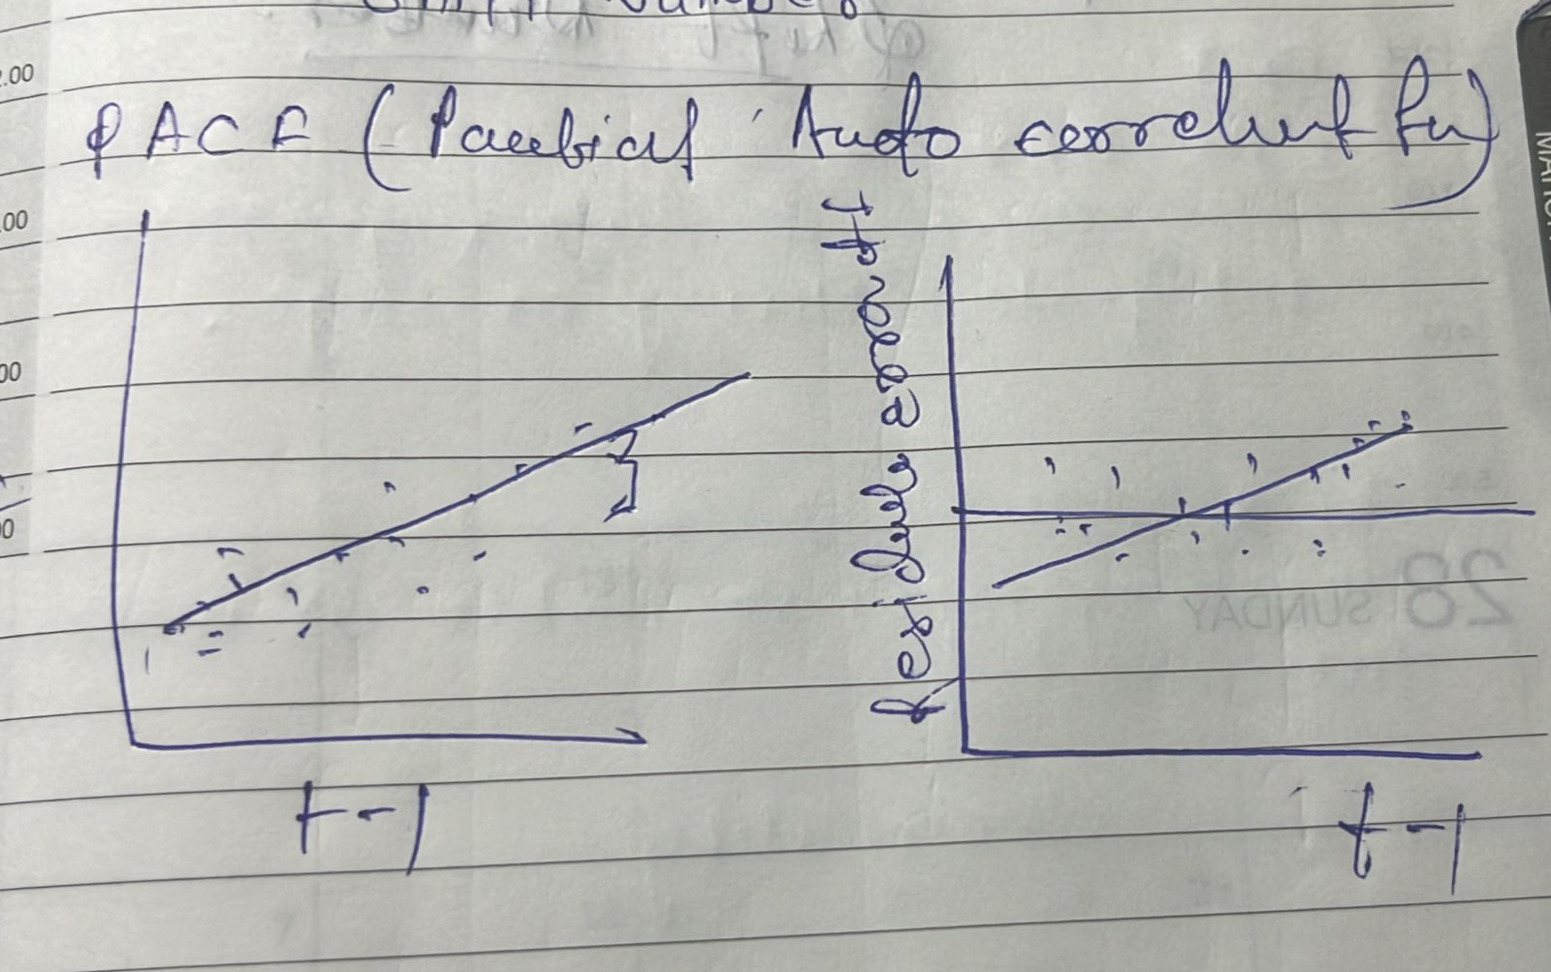
PACF(Partial Auto correlation function)

Slide 8
ARIMA
Grid search
Akaike information criterion (AIC)
Bayesian information criterion(BIC)
Hannan – Quinn information criterion(HQIC)
(p,d,q)

Slide 9
SARIMAX
Seasonal Auto Regressive Integrated Moving Average
The X at the end showes that we can use exogeneous variables as well in this model
Seasonal
Exogenous Variables
Exogeneous Variables are the independent variables or predictors that sometime help us for better prediction accuracy

Slide 10
SARIMAX
SARIMA
sesonal length
p,q,d
P,Q,D,s
Non-sesonal autoregressive order
Non-sesonal moving average
sesonal autoregressive order
sesonal moving average
Non-sesonal differencing order order
sesonal differencing order order

Slide 11
Temporal Fusion Transformer: Time Series Forecasting with Deep Learning(TFT)
Temporal Fusion Transformer (TFT) is a Transformer-based model that leverages self-attention to capture the complex temporal dynamics of multiple time sequences.

Slide 13
TFT supports:
Multiple time series: We can train a TFT model on thousands of univariate or multivariate time series.
Multi-Horizon Forecasting: The model outputs multi-step predictions of one or more target variables — including prediction intervals.
Heterogeneous features: TFT supports many types of features, including time-variant and static exogenous variables.
Interpretable predictions: Predictions can be interpreted in terms of variable importance and seasonality.

Slide 14
The Extended Time-Series Data Format
Among notable DL time-series models (e.g., DeepAR[4]), TFT stands out because it supports various types of features. These are:
Time-varying known
Time-varying unknown
Time-invariant real
Time-invariant categorical

